Slide 1



Pizza Sales Analysis
View in Power BI
Last data refresh:
12/3/2023 3:27:42 AM UTC
Downloaded at:
12/6/2023 4:52:25 PM UTC

Slide 2
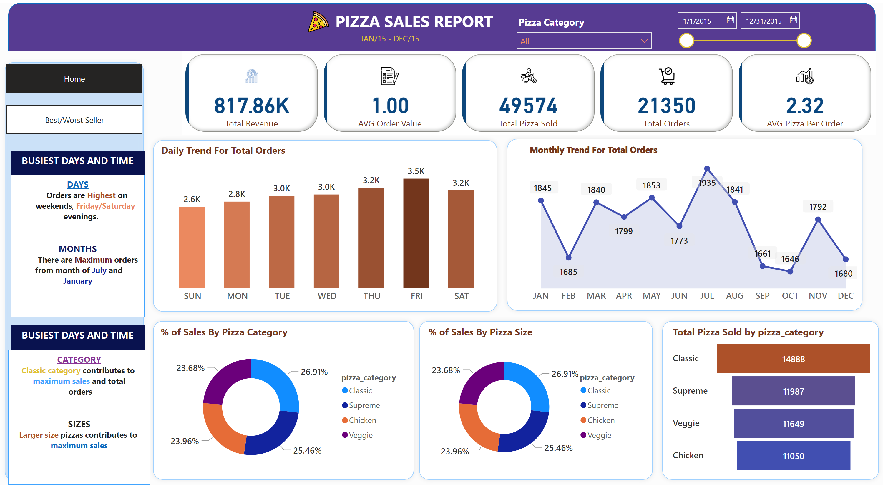
Home
Notes:
cardVisual
No alt text provided
shape
No alt text provided
textbox
No alt text provided
textbox
No alt text provided
image
No alt text provided
shape
No alt text provided
Daily Trend For Total Orders
No alt text provided
shape
No alt text provided
Monthly Trend For Total Orders
No alt text provided
shape
No alt text provided
shape
No alt text provided
shape
No alt text provided
% of Sales By Pizza Category
No alt text provided
% of Sales By Pizza Size
No alt text provided
funnel
No alt text provided
shape
No alt text provided
textbox
No alt text provided
textbox
No alt text provided
textbox
No alt text provided
textbox
No alt text provided
slicer
No alt text provided
slicer
No alt text provided
pageNavigator
No alt text provided
pageNavigator
No alt text provided

Slide 3
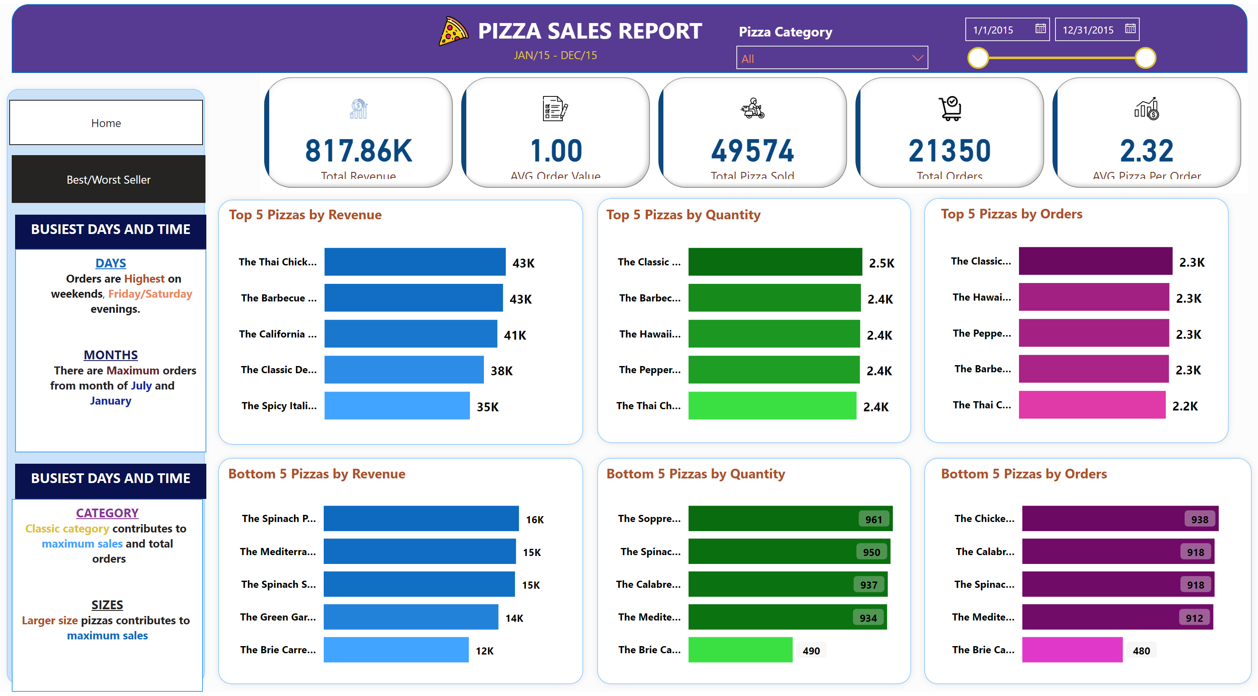
Best/Worst Seller
Notes:
pageNavigator
No alt text provided
pageNavigator
No alt text provided
Bottom 5 Pizzas by Orders
No alt text provided
Top 5 Pizzas by Orders
No alt text provided
Bottom 5 Pizzas by Quantity
No alt text provided
Top 5 Pizzas by Quantity
No alt text provided
Bottom 5 Pizzas by Revenue
No alt text provided
Top 5 Pizzas by Revenue
No alt text provided
shape
No alt text provided
slicer
No alt text provided
slicer
No alt text provided
textbox
No alt text provided
textbox
No alt text provided
textbox
No alt text provided
textbox
No alt text provided
shape
No alt text provided
shape
No alt text provided
shape
No alt text provided
shape
No alt text provided
shape
No alt text provided
shape
No alt text provided
image
No alt text provided
textbox
No alt text provided
textbox
No alt text provided
shape
No alt text provided
cardVisual
No alt text provided

